Slide 1
Introduction to Programming

Slide 2
In this class…
A tour of computer system
The first C++ program and the different stages of programming
  An introduction to the programming environment we use
  A dissection of a C++ program

Slide 3
What is a Computer System ?
Computer System is a system capable of
  Performing computations, storing data
  Making logical decisions:
    If income is greater than 25K, use higher tax rate; otherwise, use lower tax rate.
  Works billions of times faster than human beings; not smarter: good at repetitive (tedious) tasks
  Interacts with devices
Runs programs to handle different tasks:
  Balance checkbooks
  Process words, display documents
  Play games, movies, music

Slide 4
What is Computer System ?
Components of a computer system:
  Hardware: electronic and mechanical parts.
    Input devices:
    Output devices
    System Unit:
  Software: a collection of programs
    A program tells computer the sequence of steps needed to fulfill a task

Slide 5
What is Programming?
Programming — act of designing and implementing programs
  Most users are not programmers
  Programmers write instructions that comprise software in various programming languages
Programming is an essential skill for a computer scientist
Not the only skill required to be a successful computer scientist
Once certain skills are developed, even simple programs can be thrilling

Slide 6
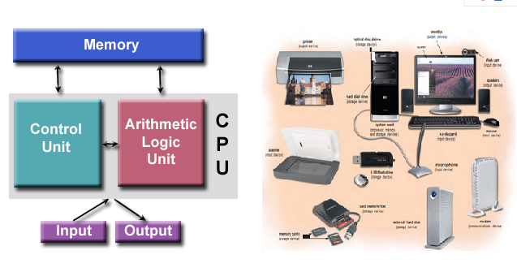
Computer Hardware
Hardware: electronic and mechanical parts.
  Input devices: Obtains data from outside computer.
    keyboard, mouse, disk or scanner
  Output devices: Makes info available outside computer.
    Screens, paper printouts, speakers
  System Unit: Disks, Memory, Processor (Central Processing Units)

Slide 7
Main Hardware Components: Processor
Central Processing Unit or CPU
  Brain of a computer system: directly or indirectly controls all the other components.
  Performs program control (locate, and execute program instructions), arithmetic, and data movement
  One operation at a time (e.g., a CPU cycle)
CPU frequency: the frequency of clock in CPU
  Not same as “instructions per second”, as some processors run multiple instructions per cycle
  One of many factors affecting the CPU speed
    Within same family of CPUs, an indicator of CPU speed

Slide 8
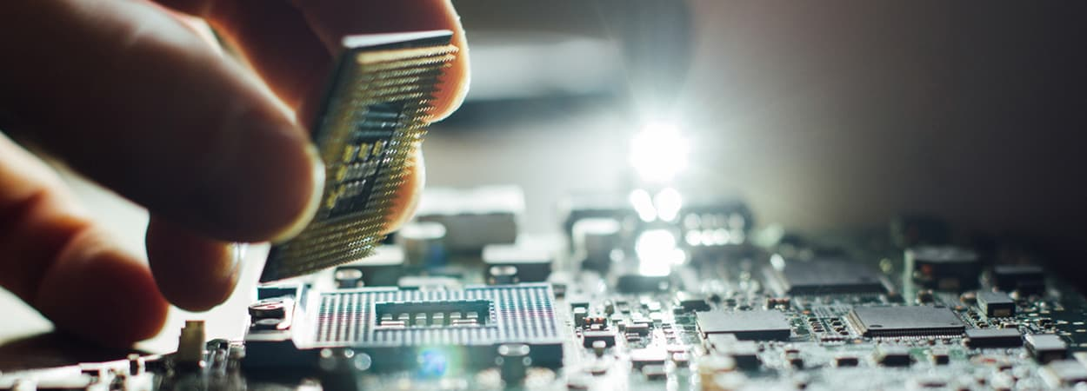
CPU
Consists of a single, or small number of, chip(s) made of mostly silicon
Composed of several billions' transistors with enormously complicated wiring
The design of CPU itself is not possible without CAD software

Slide 9
Major Hardware Components: Memory
RAM (Random Access Memory): read-write memory, volatile/temporary storage
  Holds data and programs that CPU is using, and save results of programs.
  Often called main memory, primary memory
  ROM (Read Only Memory): contains certain programs that must always be present
Secondary storage (e.g., a hard drive) provides persistent storage
  Stores programs or data not currently being used by other units on secondary storage devices (like hard disk and floppy disks)

Slide 10
Major Hardware Components: Memory
“4 gigabytes (4GB) of RAM”
  0/1 – one bit, 8 bits = 1 byte
  1024 bytes = 1 kilobyte (~10³ bytes), 1KB
  1024² bytes = 1 megabyte (~10⁶ byte), 1MB
  1024³ bytes = 1 gigabyte (~10⁹ byte), 1GB
  2⁴⁰ or 1024⁴ bytes = 1 terabyte (~10¹² byte)

Slide 11
Peripherals (Input/Output devices)
Allow the computer to interact with user and other computers:
  Output: Display, Printer, Speakers
  Input: Mouse, Keyboard
  Input/Output: Network card, Modem

Slide 12
Types of Programs
Application programs: programs that people use to get their work done
    Word Processor, Web Browsers, etc.
    Media Player, Calculator, Notepad, …
System programs keep all hardware and software running together smoothly.
  Operating System: software system developed to make using computers more convenient: Windows, Unix, Linux, MacOS, Android, …

Slide 13
So what is programming?
Specifying the structure and behavior of a program via a programming language
Testing that the program performs its task correctly and with acceptable performance
    Never forget to check that “it” works

Slide 14
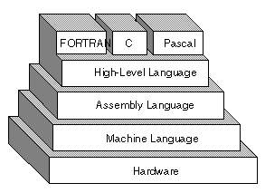
Types of Programming Languages
Three general types of programming languages
  Machine languages
    machine dependent
  Assembly languages
    machine dependent
  High-level languages
    most are portable
    Specific languages include C, C++, Python, Go, and Java

Slide 15
Programming language: Machine Code
Machine instructions: extremely primitive, e.g.
  Move memory contents to a register
  Subtract 100 from a register
  If result is positive, go (jump) to another instruction
Each type/family of processor has its own set of machine instructions
  CPU: fetch instructions in machine language (from main memory) and executes them
Machine instructions are encoded as numbers:
161 40000 45 100 127 11280
writing numeric codes manually is tedious and error prone
  thousands of instructions for a simple program

Slide 16
Programming language: Assembly language
Assembly language
  assigns short names to commands
  Can give names to memory locations
  e.g.
    mov 40000, %eax sub 100, %eax jg 11280
Makes reading easier for humans
Translated into machine instructions by the assembler , a system program
Still processor dependent
Still a great many instructions

Slide 17
Higher-level programming languages
Easiest for humans to read and write:
  if( int_rate > 100 ) cout << "Interest rate error";
Independent of the underlying hardware
  You can write a program in C++, and it can work in different Unix machine …
Translated by compilers into machine instructions
  Very sophisticated programs
  Translate logical statements into sequences of computations 161 4000 45 100 127 11280
  Find memory locations for all variable names
Much stricter than spoken languages
  Compilers don't like to guess

Slide 18
Evolution of C++
Many languages are created with a specific purpose
  database processing
    Scripting languages: PERL, Shell, Ruby, R, Python
  multimedia processing
General purpose languages can be used for any task
  C: developed to be translated efficiently into fast machine code, with minimal housekeeping overhead
  C++: adds "object oriented programming" aspects to C
As of 2022 C++ ranked fourth on TIOBE index, a measure of the popularity of programming languages, after Python, C and Java

Slide 19
History of C
Initially designed in 1972 (Kernighan & Ritchie)
Features were added in response to perceived shortcomings
Resulted in different dialects
  Bad for portability
1989 — ANSI standard of C completed

Slide 20
History of C++
1979 — Bjarne Stroustrup of AT&T adds object oriented features to C, called C with Classes
1985 — rename to C++
1998 — ISO C++ standard published, i.e., C++98
2003 — minor revision C++03.
2011 – major revision C++11 released, adding numerous new features, enlarging the standard library further
2014: a minor revision C++14
2017: major revision C++17
2020: C++20

Slide 21
Why C++?
C++ is the language that most directly allows you to express ideas from the largest number of application areas
C++ is the most widely used language in engineering areas
  Mars rovers, animation, graphics, Photoshop, GUI, OS, compilers, slides, chip design, chip manufacturing, semiconductor tools, etc.
C++ is available on almost all kinds of computers Programming concepts that you learn using C++ can be used fairly directly in other languages
  Including C, Java, C#, and (less directly) Fortran

Slide 22
In this course
Teach/learn
  Fundamental programming concepts
  Key useful techniques
  Basic Standard C++ facilities
  Object Oriented Programming
After the course, you’ll be able to
  Write small colloquial C++ programs
  Read much larger programs
  Learn the basics of many other languages by yourself
  Proceed with an “advanced” C++ programming course
After the course, you will not (yet) be
  An expert programmer
  A C++ language expert
  An expert user of advanced libraries

Slide 23
First C++ Program

Slide 24
Edit, Compile, and Execute C++ Program
Edit the program using C++, save it in a file with suffix .cc, or .cpp, e.g., Hello.cc
  Editor we use: Go for your preferred one
Compile the program (actually multiple steps invovled: preprocess, compile and link): type following command in command line to compile the program Hello.cpp
  g++ Hello.cpp -o Hello
  This creates an executable file named Hello.exe
Run the executable file
  .\Hello.exe

Slide 25
Hello.cpp or cc
// Text-printing program.
#include <iostream> // allows program to output data to // the screen
// function main begins program execution
int main()
{
std::cout << "Welcome to C++!\n"; // display message
return 0; // indicate that program ended successfully
} // end function main

Slide 26
Important Parts of a C++ program
Comments: //, /* …. */
Preprocessor directives : #include
Function main
  Body of the function
  Return statement
  Other statements
White spaces
  Blank lines, space characters and tabs
  Delimiter, used to make programs easier to read
  Extra spaces are ignored by the compiler

Slide 27
Comments
Explain programs to other programmers
  Improve program readability
Ignored by compiler => does not change behavior of a program
Single-line comment
  Begin with //
Multi-line comment
  Start with /*
  End with */

Slide 28
Preprocessor Directives
Processed by preprocessor before compiling
Begin with #
Example
  #include <iostream>
    Tells preprocessor to include the input/output stream header file <iostream>

Slide 29
Function main
A part of every C++ program
  Every program has exactly one main function
  main is a keyword.
    keyword : a word in code that is reserved by C++ for a specific use.
Header of function main : int main( )
  main( ) is a function that takes no arguments ( )
and returns an int (integer value) to indicate success or failure
Body of a function is delimited by braces ({ })

Slide 30
Statements
Lines in your program that instruct the computer to perform an action
All statements end with a semicolon (;)
Examples :
  return 0;
  std::cout << " Hello world!\n ";

Slide 31
return Statement
One of several means to exit a function
When used at the end of main
  The value 0 indicates the program terminated successfully
  Example
    return 0;

Slide 32
Output Statement (1)
std::cout << " Hello world!\n ";
  std::cout
    Standard output stream object, something that represents your “standard” output device (normally linked to computer screen)
    Defined in input/output stream header file <iostream>
    We are using a name (cout) that belongs to “namespace” std.
  Stream insertion operator <<
    Value to right (right operand) inserted into left operand.

Slide 33
Output Statement (2)
std::cout << " Hello world!\n ";
Quotes delimit a string literal
NOTE: “smart” quotes “ ” will cause compiler problems.
so make sure your quotes are of the style " "

Slide 34
Output Statement (3)
Escape character : backslash : "\"
Escape sequence : a character preceded by backslash
  Indicates “special” character output that cause some actions to the output
  e.g.
    \n : newline, move cursor to beginning of next line on the screen
    \t: horizontal tab, move cursor to the next tab stop.

Slide 35
“Hello World!”
// Text-printing program.
#include <iostream> // allows program to output data to // the screen
// function main begins program execution
int main()
{
std::cout << "Welcome to C++!\n"; // display message
return 0; // indicate that program ended successfully
} // end function main

Slide 36
Hello, world!
The first program help you get used to
  Editor
  Compiler
  Program development environment
  Program execution environment
Type in the program carefully
  After you get it to work, please make a few mistakes to see how the tools respond; for example
    Forget the header
    Forget to terminate the string
    Misspell return (e.g. retrun)
    Forget a semicolon
    Forget { or }
    …

Slide 37
Modifying Our First C++ Program
Print text on one line using multiple statements
  Each stream insertion resumes printing where the previous one stopped
  Statements:
  Std::cout << “Welcome ”;
  Std::cout << “to C++!\n”;
CISC1600 Xiaolan Zhang
Spring 2013

Slide 38
Modifying Our First C++ Program
Print text on several lines using a single statement.
  Each newline escape sequence positions the cursor to the beginning of the next line
  Two newline characters back to back outputs a blank line
  Example statement :
  Std::cout << “Welcome\nto\n\nC++!\n”;

Slide 39
Programming
Programming is fundamentally simple
  Just state what the machine is to do
So why is programming hard?
  We want “the machine” to do complex things
    And computers are nitpicking, unforgiving, dumb beasts
  The world is more complex than we’d like to believe
    So we don’t always know the implications of what we want
  “Programming is understanding”
    When you can program a task, you understand it
    When you program, you spend significant time trying to understand the task you want to automate

Slide 40
Programming
Except for the work you hand in as individual contributions, we strongly encourage you to collaborate and help each other
If in doubt if a collaboration is legitimate: ask!
  Don’t claim to have written code that you copied from others
  Don’t give anyone else your code (to hand in for a grade)
  When you rely on the work of others, explicitly list all of your sources – i.e. give credit to those who did the work
Don’t study alone when you don’t have to
  Form study groups
  Do help each other (without plagiarizing)

Slide 41
In Summary
We learnt about Computer System Organization
Hardware: CPU, Memory, Secondary Storage, Input and Output
Software & Programming Languages
  Application program vs System program
Programming in C++
  Different parts of C++ source code
  Source code =>Preprocessor, compiler, linker => Executable

Slide 42
The next lecture
Will talk about types, values, variables, declarations, simple input and output, very simple computations, and type safety.

